Slide 1
China
Tang Dynasty
Song Dynasty
Mongol Empire and Chinese Resurgence

Slide 2
Tang Dynasty
Tang Dynasty (618-907)
  Multicultural Exchange
    Silk Road
    Chang׳an
  Imperial Structure
    Emperor
      Li Shimin (r. 626-649), Emperor Taizong
  Advances

Slide 3
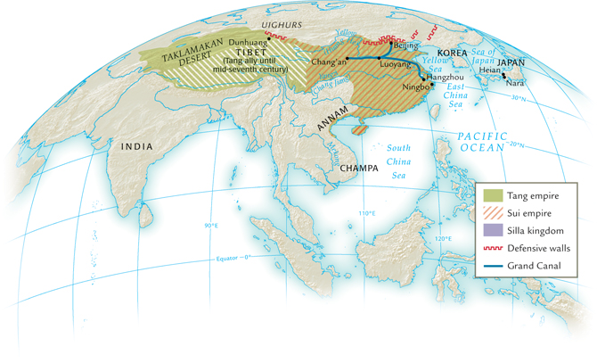

Slide 4
Song Dynasty
Song Dynasty (960-1279)
  Society
    Government established schools
    Gender
  Philosophy
    Neo-Confucianism
      Zhu Xi
        qi

Slide 5
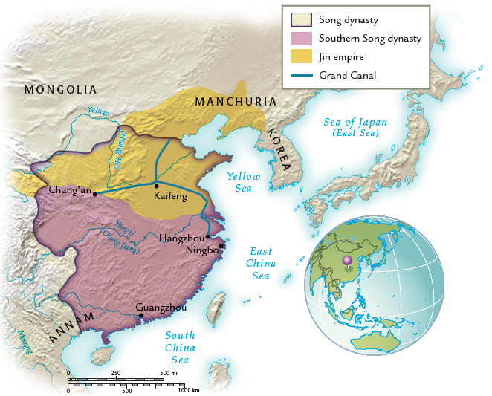

Slide 6
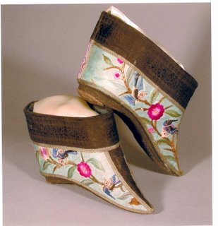
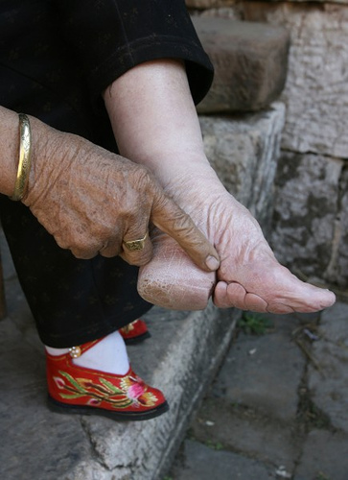

Slide 7
Mongol Empire and Chinese Resurgence
Mongol Empire
  Khubilai Khan
  Yuan Dynasty (1279-1368)
Ming Dynasty (1368-1644)
  Hongwu (r.1368–1398)
    Mandarins
  Yongle (r. 1403–1424)
    Naval Expeditions
  Great Wall
  Intellectual Pursuits
  Imperial Expansion
  Middle Kingdom

Slide 8
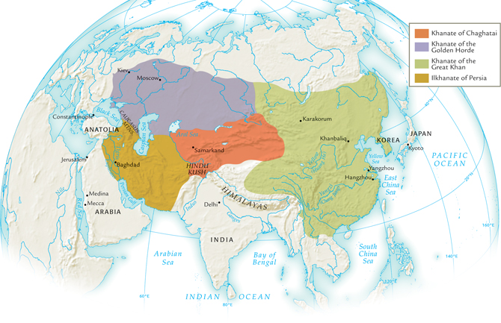

Slide 9
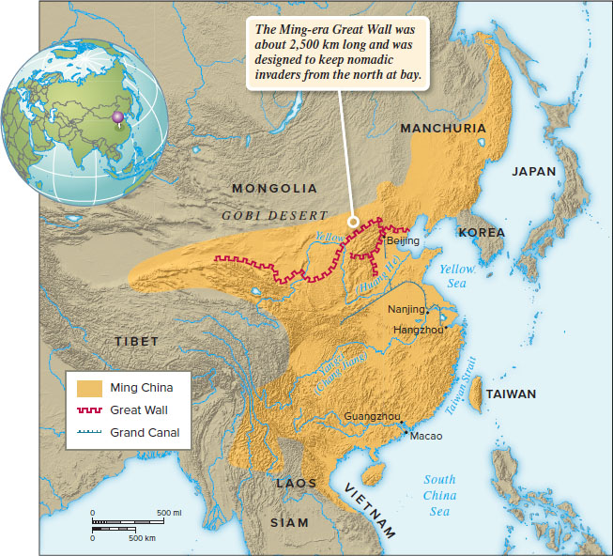

Slide 10
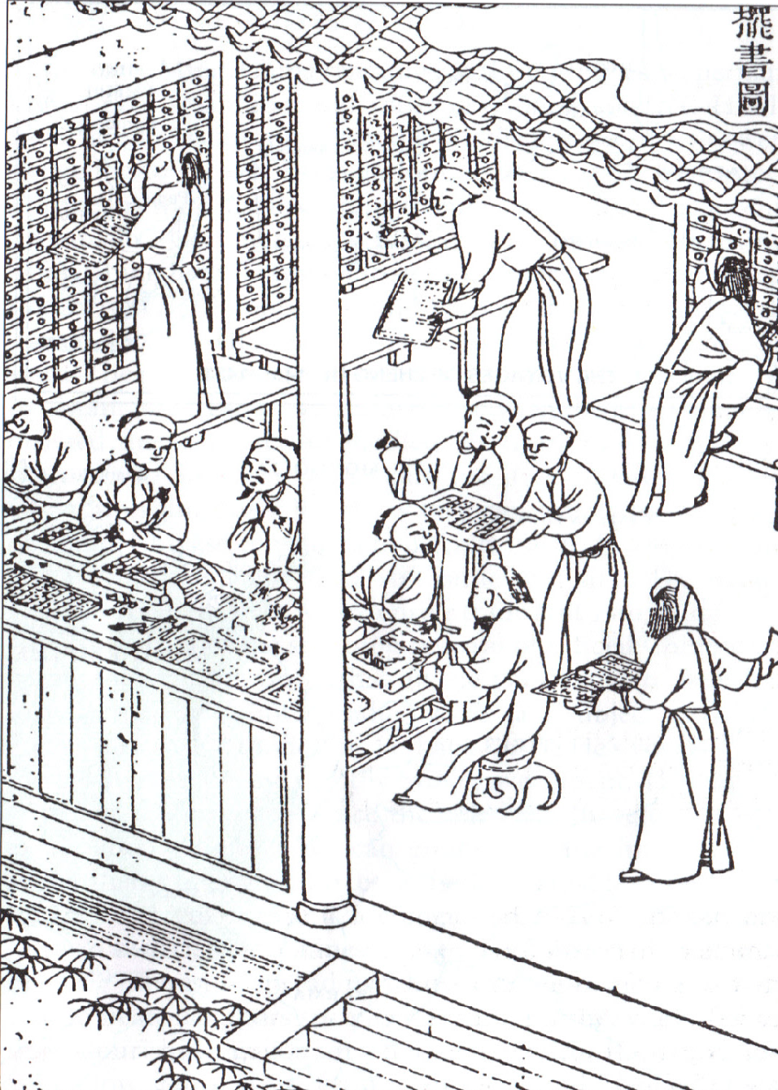
Ming Imperial Print shop

